Slide 1
qb
Go-Team presents
the one game platform that every flock user should have

Slide 2
Introduction
Ever got bored with hefty work, collaborating with co-workers, associates, colleagues. Are you a flock user? Do you have a serious team working on an awesome project and need intellectual breaks between? Felt like playing some games? Challenging colleagues about their knowledge?
Well here we come with a solution, a multiplayer game `qb`, the cubical game for developers.

Slide 3
Why qb
Flock no doubt provides the best facilities for its developers to develop the best product but it lacks in providing them refreshment at the time of work. So we `goTeam` brings you the first ever multiplayer platform for flockOS.
Every team needs refreshment while working over flock. Why don’t you make that an intellectual break? Increase your knowledge? Challenge co-worker? Play a multiplayer game ? So we are here to fill that space left out by the flock team providing refreshment for users.

Slide 4
Features of qb
Multiplayer game (Can be played individually also).
Crossword puzzle
Challenge anyone over the world
Find the answer for the given question in the 3-D crossword puzzle
Questions designed on users interests.
World wide ranking for each topic like Python, JS, Node, Networking, C++ …

Slide 5
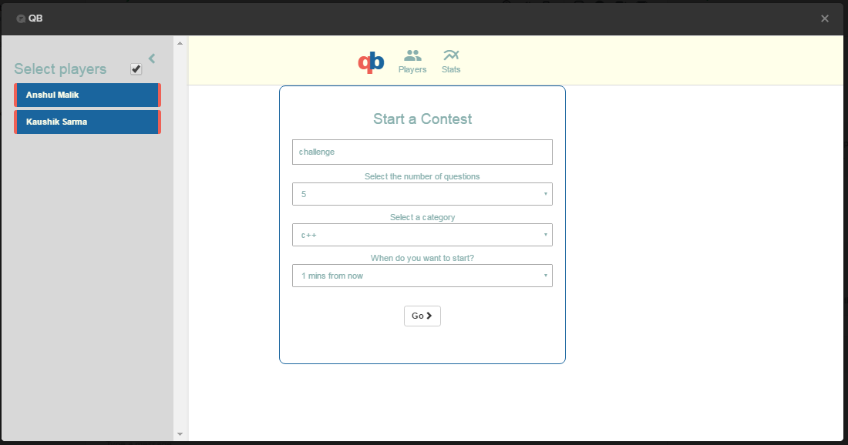
qb

Slide 6
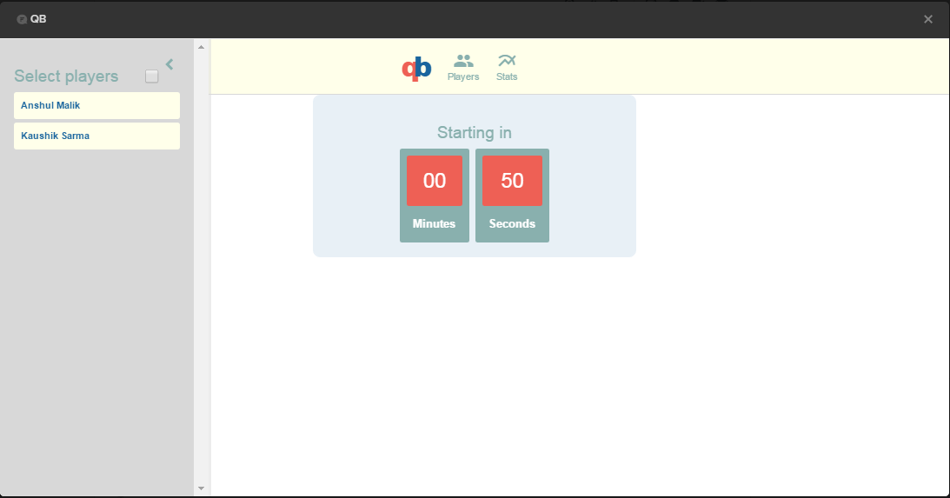
qb

Slide 7
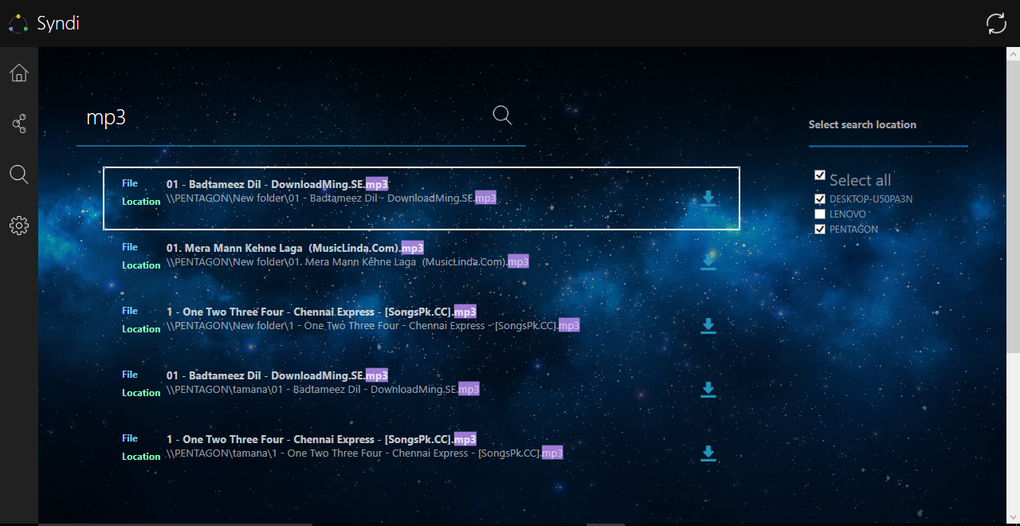
Syndi2.0

Slide 8
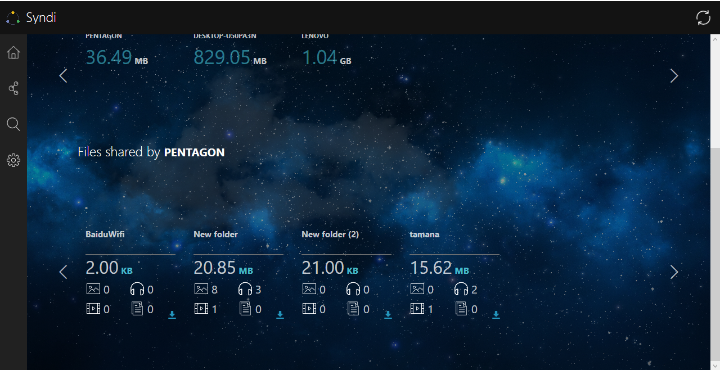
Syndi2.0

Slide 9
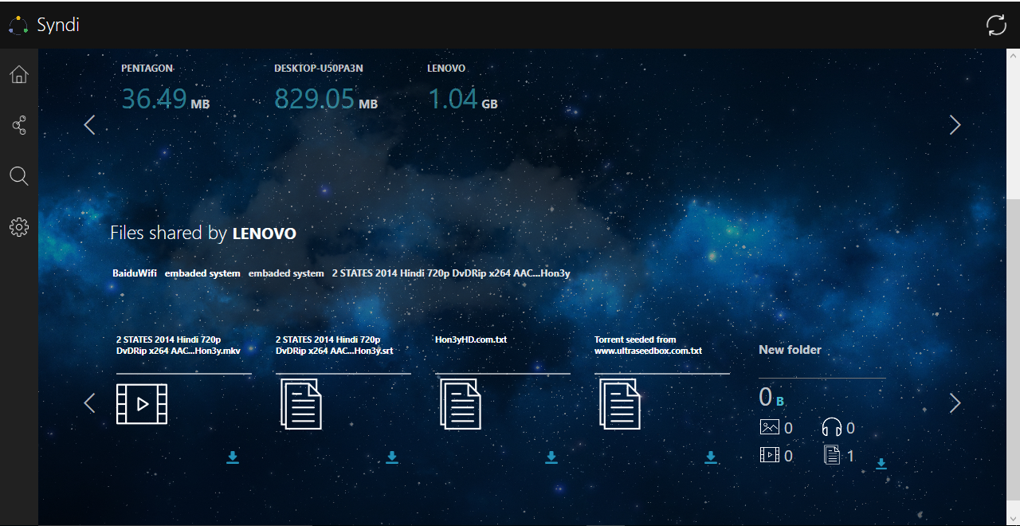
Syndi2.0

Slide 10
Syndi2.0 vs Windows Explorer
Our explorer gives more accurate results than the Windows Explorer.
Syndi search bar is far better than Windows search bar w.r.t time and functionalities.
The next slide shows a proof why our Explorer is better than the Windows Explorer.

Slide 11
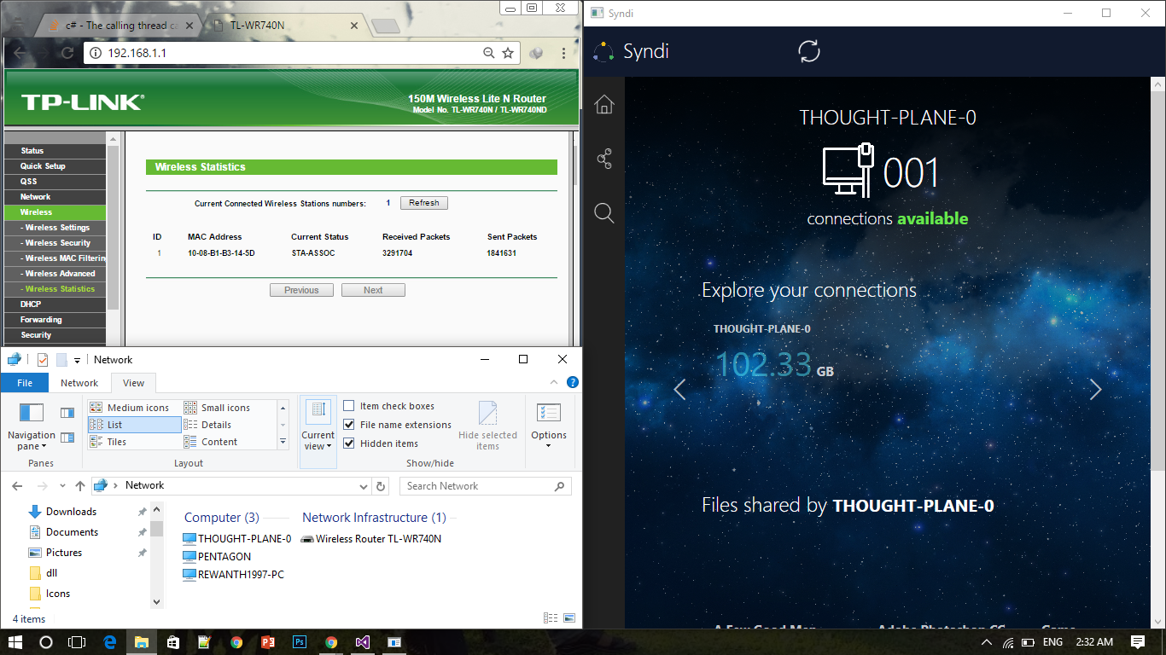
Syndi2.0 vs Windows Explorer

Slide 12
Future Scope and plans
We will be implementing a chat option by which the user can communicate with other users and ask for particular files to share if any other user is having them. There will be a private chat as well as a broadcast chat.
Currently this is available only for Windows, we would soon release our next version for cross platform.

